Slide 1

Predicting Heart Disease Risk: Analyzing Health and Socio-Economic Indicators Aisha Mohammad

Slide 2

Contents:
Literature review
Literature review - Zotero
Data Source identification
Phase 1 – Technical requirements
MVP

Slide 3
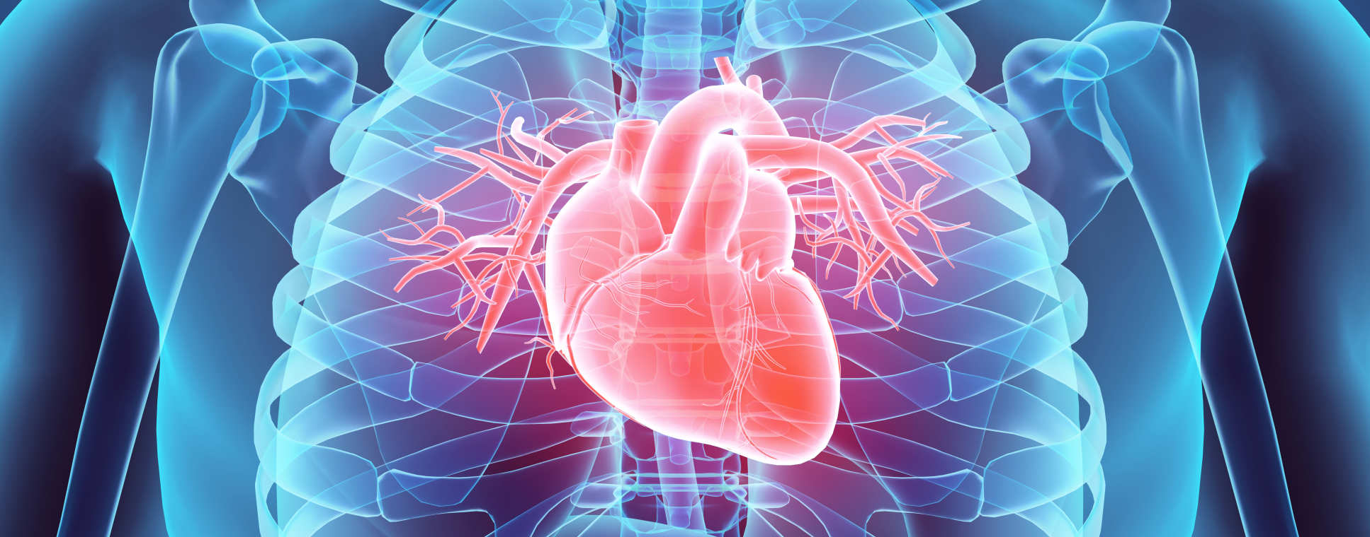
LITERATURE REVIEW
Scope: Articles from journals dating from 2019-2024 have been studied.
Relevance: These articles are all related to heart disease prediction and significance of socio-econimic determinants of health.
Objective: The studies aim to predict heart disease using various techniques such as ML algorithms, EDA, DL neural networks, Visualizations and feature selection. Diverse datasets were used to perform these analysis.
A 3 page detailed literature review was created by doing a carreful literature survey.

Slide 4
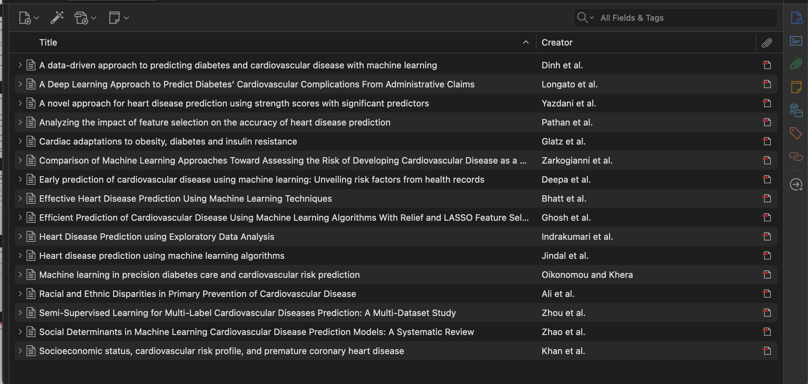
Literature articles - Zotero

Slide 5
Data justification
For this capstone project, I will utilize two well-curated datasets:
Diabetes Binary Health Indicators Dataset:
Sourced from Kaggle, this dataset contains 253,680 survey responses from the 2015 Behavioural Risk Factor Surveillance System (BRFSS) conducted by the CDC.
It was cleaned and reduced by Alex Teboul to 21 feature variables from the original dataset of 441,455 responses with 330 features.
The dataset includes health-related risk behaviours, chronic conditions, and preventive service usage but is imbalanced, offering opportunities for data pre-processing.
Heart Disease Comprehensive Dataset:
Retrieved from IEEE DataPort, this dataset was created by Manu Siddhartha by combining five popular heart disease datasets from the UCI ML repository.
It integrates 11 common features, making it the largest heart disease dataset currently available for research, with a focus on cardiovascular conditions.
Rationale: Using Azure ML, these datasets will be merged to provide a unified source for an in-depth analysis of the relationship between diabetes, socio-economic factors, and heart disease. This combination leverages the strengths of both datasets to support comprehensive analysis and actionable insights.

Slide 6
Phase 1 – Technical requirements
Data Pre-processing: loaded datasets, standardized numerical data, and checked for null values.
Imputation of Missing Values: All features were assessed for null values. No missing values were identified in either dataset, eliminating the need for imputation.
Addressing Imbalanced Data and Resampling Techniques: applied resampling techniques, to up sample the first dataset.
Feature engineering
StandardScaler was used for numerical data. Moving forward the following will be applied:
Feature Selection: Identifying and selecting the most relevant features.

Slide 7
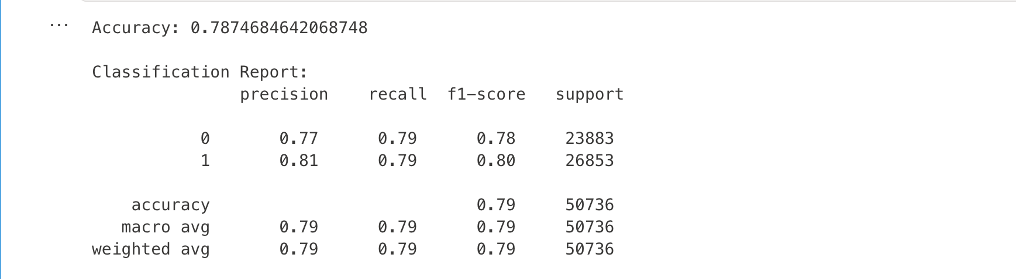
MVP
Data preprocessing:
Did Standard scaling for numerical data, checked for null values and combined both datasets into a new dataset called ‘combined’.
Dropped columns from new dataset that were not needed, for simpler model development for MVP. Also dropped columns that were similar in both datsets.
Model selection:
Logistic regression was applied on ‘combined’ because it is easy to interpret and it’s simplicity makes it fast to train. Since ‘target’ variable is binary, this model is well suited as it outputs probabilities.
Model Performance:
The model achieves an accuracy of ~79%, which is reasonable for a binary classification problem.

Slide 8
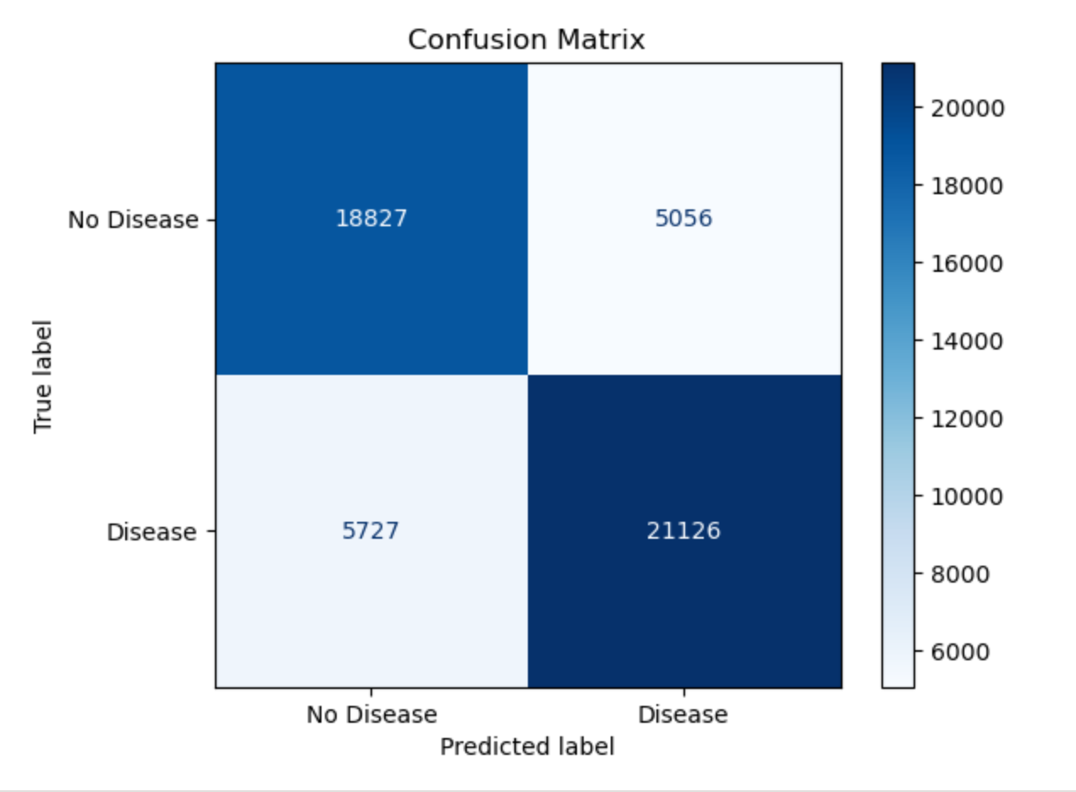
MVP visualization
This confusion matrix shows the performance of a model predicting Disease vs. No Disease:
True Negatives (TN): 18,827 correctly predicted No Disease.
False Positives (FP): 5,056 incorrectly predicted as Disease.
False Negatives (FN): 5,727 incorrectly predicted as No Disease.
True Positives (TP): 21,126 correctly predicted Disease.
This indicates a strong model with good precision, but there's room to improve recall by reducing false negatives.
Overall, the model offers a reliable foundation for predicting disease outcomes, suitable for use in real-world applications with some fine-tuning.

Slide 9
Tools :-
LINKS:-
Zotero
GitHub
Azure ML – notebooks
Jira – Gantt chart
MVP code Capstone MVP.ipynb - Azure Machine Learning
Capstone project code Capstone.ipynb - Azure Machine Learning
GitHub https://github.com/Aisha-datatech/Capstone-Project
Jira
https://saintpeters-team-hisfhzp1.atlassian.net/jira/core/projects/DTP/timeline?rangeMode=weeks&atlOrigin=eyJpIjoiZTI2YzQwYWQ4ZjcwNGY1ZWIyMGQ2YzU0YWY0NzRlYjEiLCJwIjoiaiJ9

